Slide 1
Thermodynamics
Lecture 2C:
Energy Transfer, General Energy Analysis
Pure substances
Notes:
Remarks:
Practice exam CBTF
Project

Slide 2
After this lecture
Understand energy analysis of open systems and cycles.
Define energy conversion efficiency.
Introduction to pure substances and phase change processes.

Slide 3
Learning objectives
What you will be able to do after this course:
Knowledge: Write the first and second laws of thermodynamics.
Comprehension: Describe the first and second laws in the student’s own language.
Application: Solve simple single-answer problems using the first law.
Analysis: Solve problems requiring both the first and second laws.
Synthesis: Develop schemes to improve the efficiency or performance of thermodynamic systems, e.g., compressors, turbines, heat pumps, etc.

Slide 4
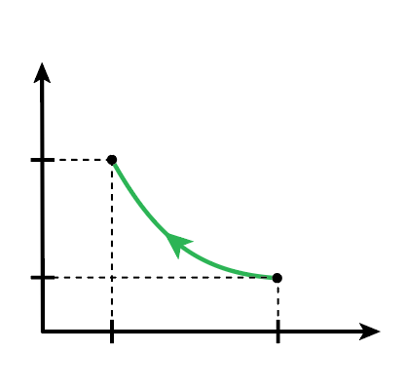



Recap Lecture 2B
$$W=\int_{1}^{2}{pdV}$$
Boundary work
p
p₂
2
Inexact differentials
$$δQ;δW$$
Exact differentials
$$dV$$
p₁
1
V₂
V₁
V
Notes:
Path dependence
First law

Slide 5
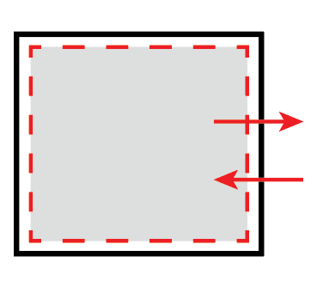
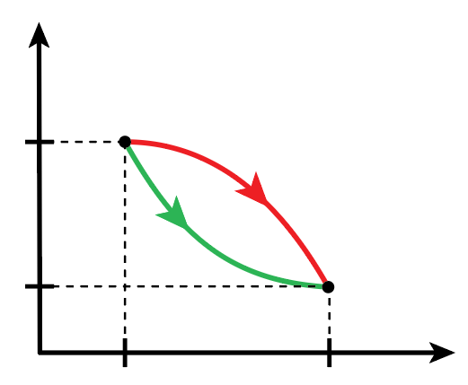
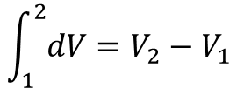


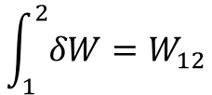





Recap Lecture 2B
W and Q are path dependent
$$\int_{1}^{2}{dV}=V_{2}−V_{1}$$
$$\int_{1}^{2}{δW}=W_{12}$$
$$E_{out}$$
p
$$ΔE_{system}$$
$$ΔV_{A}=ΔV_{B}$$
2
$$E_{in}$$
p₂
$$W_{A}≠W_{B}$$
Process B
Process A
$$E_{in}−E_{out}=ΔE_{system}$$
p₁
1
$$ΔU=Q−W$$
V₂
V₁
V
Notes:
Path dependence
First law

Slide 6






Energy transfer in/out of a closed system
Account for energy transfer with surroundings.
$$E_{in}−E_{out}=\left(Q_{in}−Q_{out}\right)+\left(W_{in}−W_{out}\right)$$
$$E_{out}$$
$$Q$$
$$−W$$
$$ΔE_{system}$$
Heat in: $Q$> 0
Work out:$W$> 0
$$E_{in}$$
Notes:
Again conventions

Slide 7
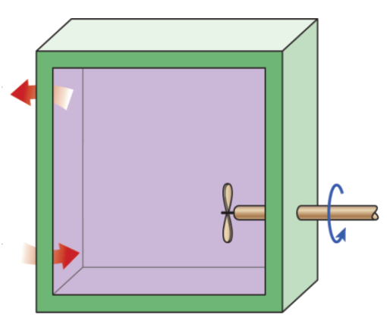










1st Law of thermodynamics: Example II
Determine U₂ of the air inside the box.
Define the system
$$Q_{out}=500 kJ$$
$$ΔU=Q−W$$
$$W=−100 kJ ;$$
$$U_{1}=800 kJ$$
$$U_{2}=?$$
$$W_{sh,in}=100 kJ$$
$$ΔU=U_{2}−U_{1}$$
$$Q=Q_{in}−Q_{out}=1500 kJ$$
$$Q_{in}=2000 kJ$$
$$U_{2}=Q_{in}−Q_{out}+W_{shaft,in}+U_{1}$$
$$U_{2}=Q_{in}−Q_{out}+W_{shaft,in}+U_{1}=2400 kJ$$
Notes:
2400, 2200, 3200, 3400, 2900

Slide 8

Recap exercise: Isochoric process
Question:
What is the work extracted during a process of isochoric heating in a cylinder from state 1 to state 2:
To Do:
Determine the relevant equation for Work.
Simplify and rewrite that equation
Go to pollev.com/claudiohail
… and answer question 1.

Slide 9
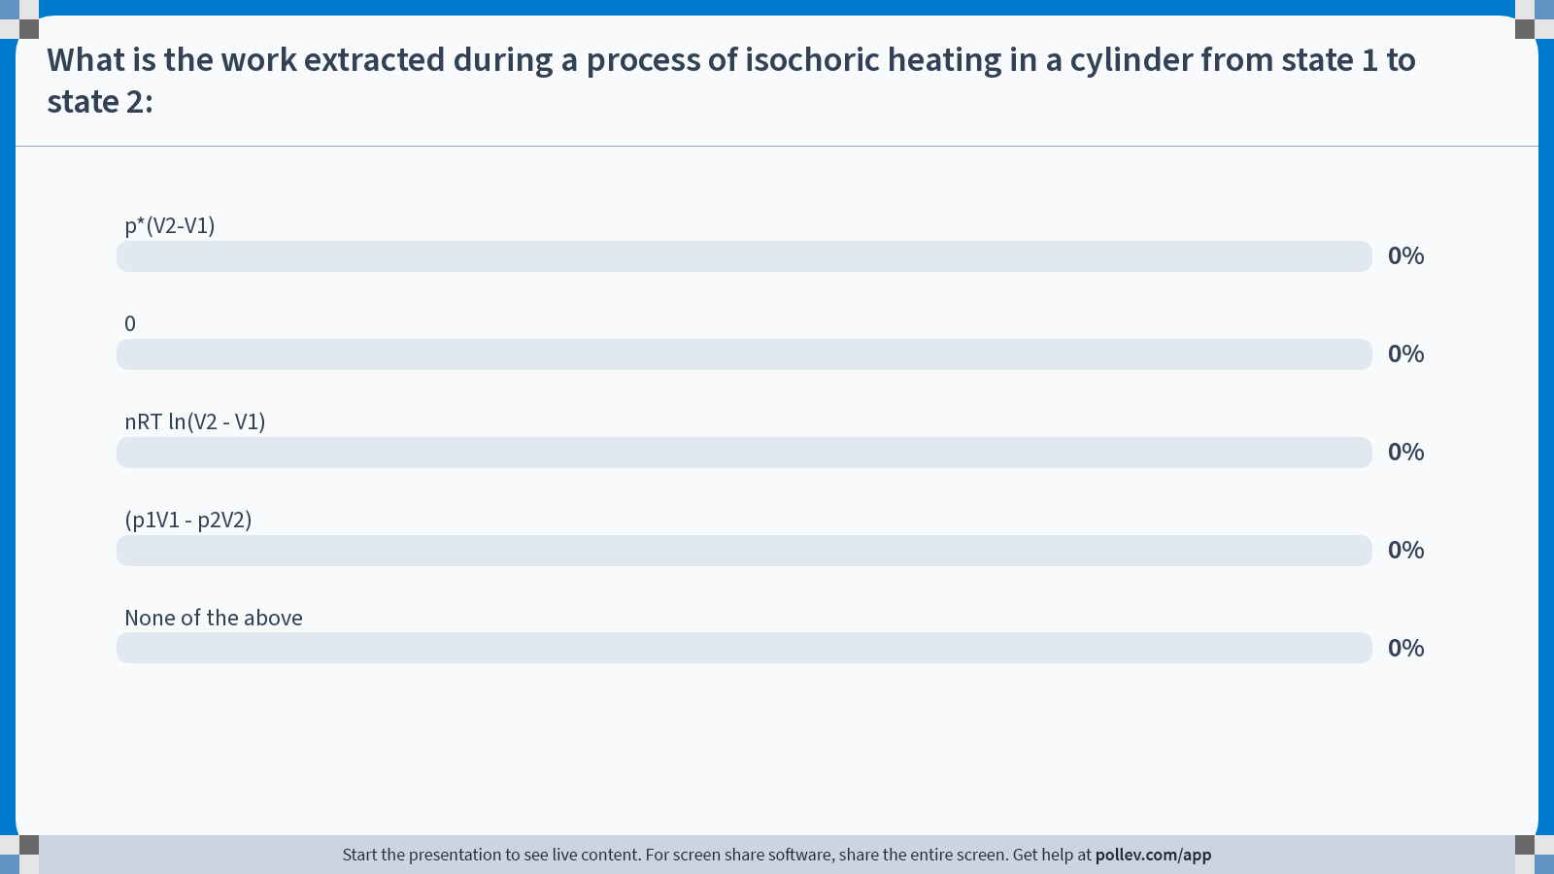
Poll Everywhere multiple choice poll activity
Activity Title: What is the work extracted during a process of isochoric heating in a cylinder from state 1 to state 2:
Slide 9
Notes:
Do not modify the notes in this section to avoid tampering with the Poll Everywhere activity.
More info at polleverywhere.com/support
What is the work extracted during a process of isochoric heating in a cylinder from state 1 to state 2:
https://www.polleverywhere.com/multiple_choice_polls/aFYT8fikc9ZQaEIV0HxUE?state=opened&flow=Default&onscreen=persist

Slide 10
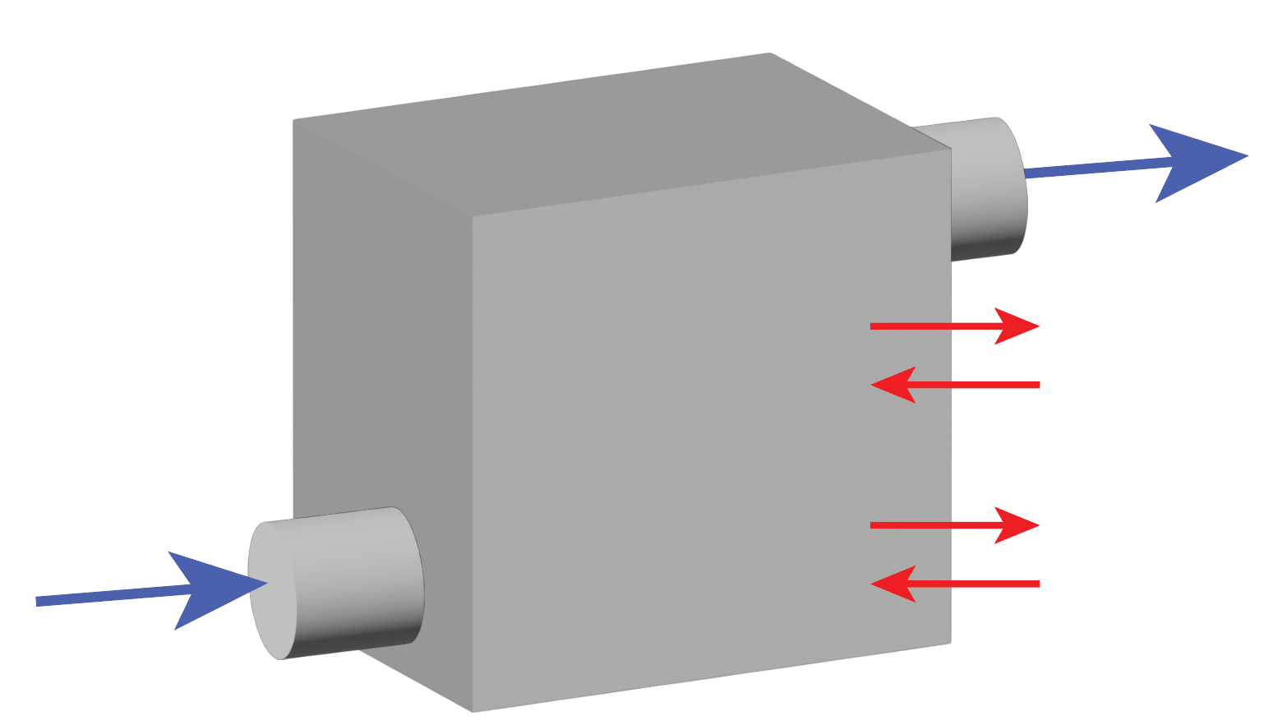








1st Law of thermodynamics: Open system
Mass flows carry energy in/out.
$${\dot{m}}_{out}$$
$$Q_{out}$$
$$E_{in}−E_{out}=$$
$$Q_{in}$$
$$W_{out}$$
$$W_{in}$$
$$ΔE_{system}=$$
$${\dot{m}}_{in}$$

Slide 11
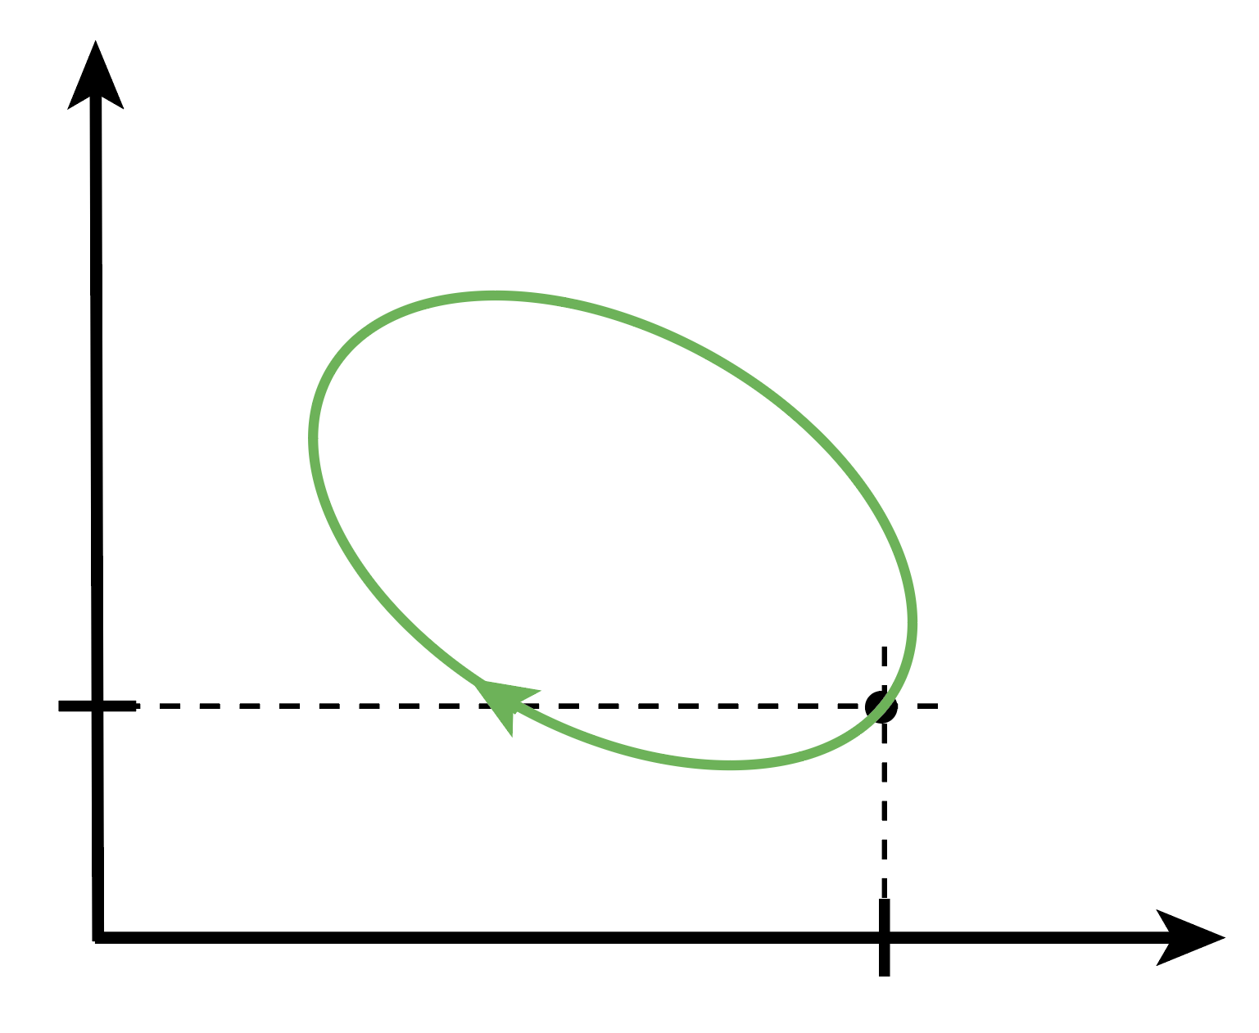
Energy analysis of thermodynamic cycles
A closed system undergoing a thermodynamic cycle.
p
p₁
V
V₁

Slide 12
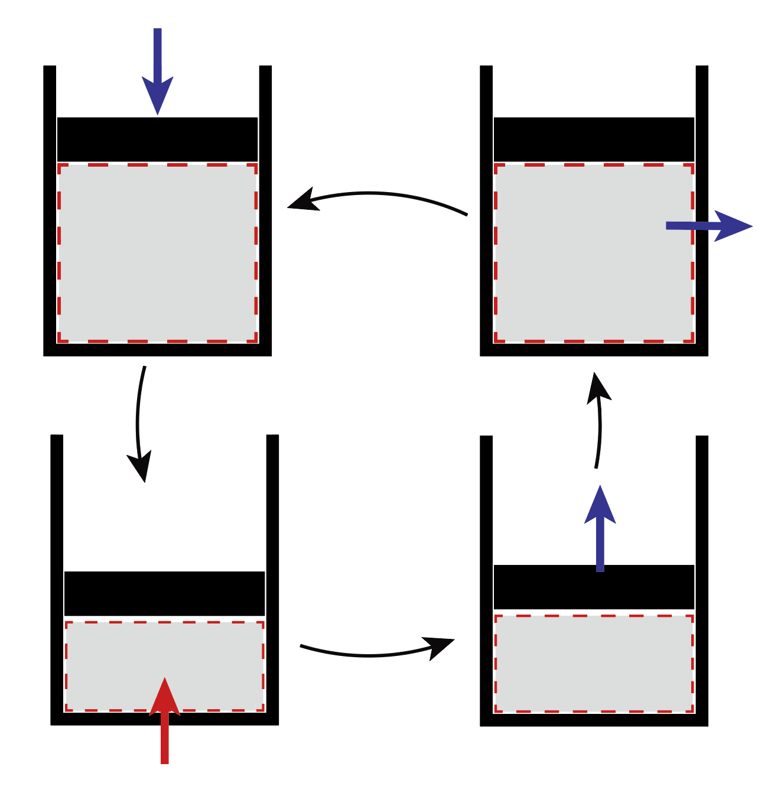




Energy analysis of thermodynamic cycles
Example of a closed cycle process of gas in a piston
1
$$W_{12}$$
4
isochoric
$$Q_{41}$$
adiabatic
adiabatic
$$W_{34}$$
3
2
$$Q_{23}$$
isochoric

Slide 13
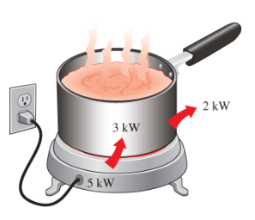


Energy conversion efficiencies (I)
Denoted by Greek letter $η$
$$Efficiency=\frac{Desired output}{Required input}≤1$$
1
$$W_{12}$$
4
$$Q_{41}$$
2
$$W_{34}$$
$$Q_{23}$$
Notes:
Heater: depending on the heating, electrical, thermal
Solar cell, IC engine, El. Motor,

Slide 14
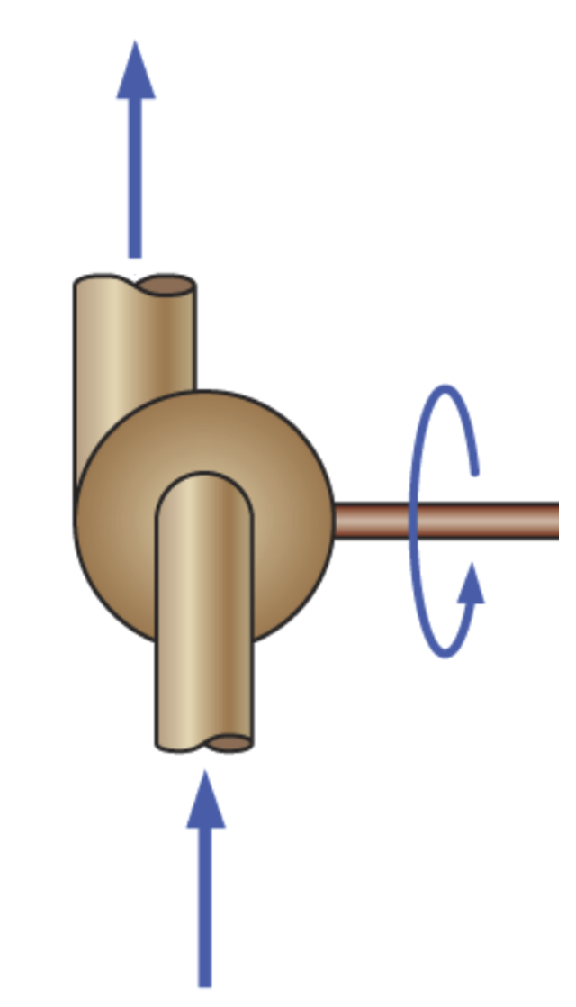
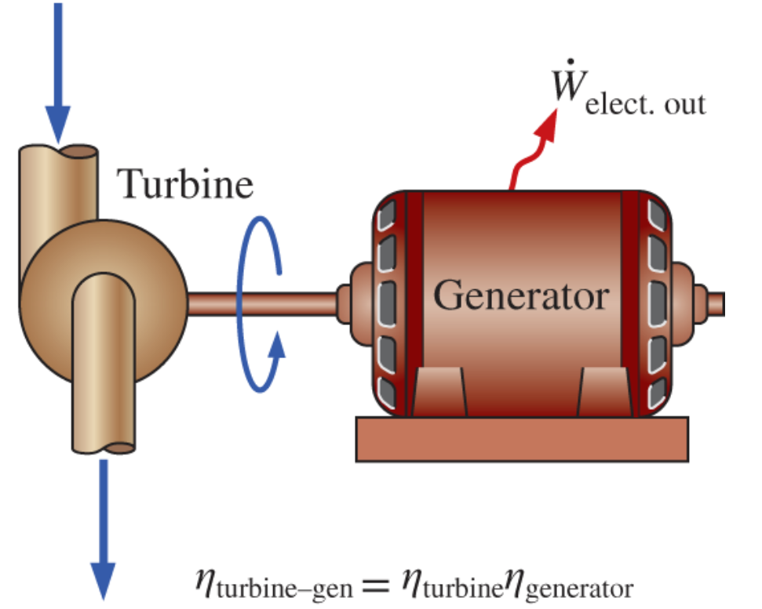




Energy conversion efficiencies (II)
Pump
Turbine
p₂
p₁
Pump
p₁ > p₂
p₂ > p₁
$${\dot{W}}_{shaft,in}$$
$${\dot{W}}_{shaft,out}$$
p₁
p₂
$$η_{pump}=\frac{Mech. energy increase fluid}{Mech. energy input}=\frac{Δ{\dot{E}}_{mech,fluid}}{{\dot{W}}_{shaft}}$$
$$η_{turbine}=\frac{Mech. energy output}{Mech. energy decrease fluid}=\frac{{\dot{W}}_{shaft,out}}{Δ{\dot{E}}_{mech,fluid}}$$

Slide 15
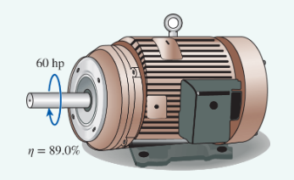


Energy conversion efficiencies (III)
Motor
Generator
$${\dot{W}}_{shaft,in}$$
$${\dot{W}}_{shaft,out}$$
$${\dot{W}}_{elec,in}$$

Slide 16
Energy conversion efficiencies
Combining efficiencies of multiple devices in series:

Slide 17
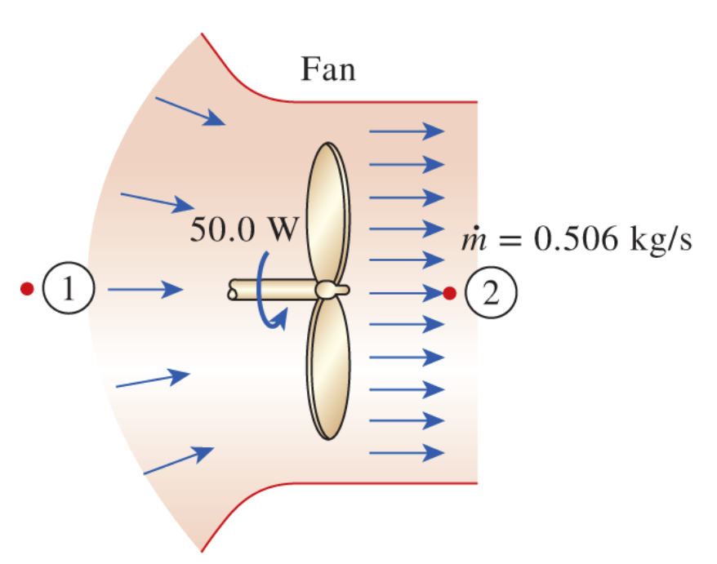





Group Work: in groups of 2; solve the following problem.
Given:
Question:
What is the efficiency of this device? Give a formula and value.
$$W_{shaft,in}=40 W$$
$$0.6 kg/s$$
To Do:
Define the thermodynamic system of interest.
Determine the change in energy of the fluid.
Determine the efficiency.
Go to pollev.com/claudiohail
… and answer question 1.
$$V_{1}=0 ; V_{2}=10 m/s$$
$$z_{1}=z_{2}$$
$$P_{1}≈P_{atm} ; P_{2}≈P_{atm}$$

Slide 18
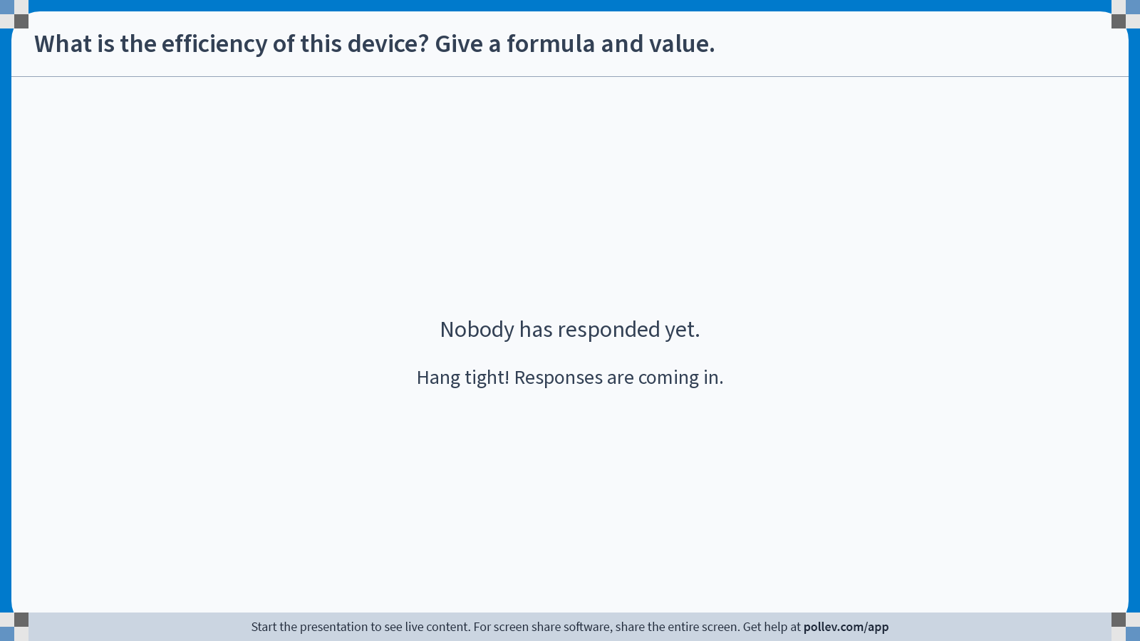
Poll Everywhere free text poll activity
Activity Title: What is the efficiency of this device? Give a formula and value.
Slide 13
Notes:
Do not modify the notes in this section to avoid tampering with the Poll Everywhere activity.
More info at polleverywhere.com/support
What is the efficiency of this device? Give a formula and value.
https://www.polleverywhere.com/free_text_polls/HbVIUakbdu5zGc6SZBpgv

Slide 19
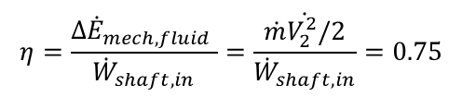

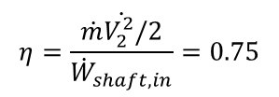
Group Work: in groups of 2; solve the following problem.
Given:
$$η=\frac{Δ{\dot{E}}_{mech,fluid} }{{\dot{W}}_{shaft,in}}=\frac{\dot{\dot{m}V_{2}^{2}/2}}{{\dot{W}}_{shaft,in}}=0.75$$
$$W_{shaft,in}=40 W$$
$$0.6 kg/s$$
$$Δ{\dot{E}}_{mech,fluid}=ΔU+ΔKE+ΔPE=\frac{1}{2}\dot{m}(V_{2}^{2}−V_{1}^{2})$$
$$η=\frac{\dot{\dot{m}V_{2}^{2}/2}}{{\dot{W}}_{shaft,in}}=0.75$$
$$V_{1}=0 ; V_{2}=10 m/s$$
$$z_{1}=z_{2}$$
$$P_{1}≈P_{atm} ; P_{2}≈P_{atm}$$

Slide 20










Summary: Energy & General Energy Analysis
Mass flow:
Energy balance:
$$\dot{m}=ρ\dot{V}=ρA_{c}V_{avg}$$
$$E_{in}−E_{out}=ΔE_{system}$$
Mechanical energy:
Energy balance (rate):
$${\dot{E}}_{mech}=\dot{m}e_{mech}=\dot{m}\left(\frac{P}{ρ}+\frac{V^{2}}{2}+gz\right)$$
$${\dot{E}}_{in}−{\dot{E}}_{out}=\frac{dE_{system}}{dt}$$
Electrical work
1st law closed system:
$$W_{e}=UIΔt$$
$$ΔU=W−Q$$
Shaft work
$$W_{sh}=2πnT$$
Energy conversion efficiency:
Spring work
$$Efficiency=\frac{Desired output}{Required input}$$
$$η=\frac{W_{net}}{Q_{in}}$$
$$W_{spring}=\frac{1}{2}k\left(x_{2}^{2}−x_{1}^{2}\right)$$

Slide 21
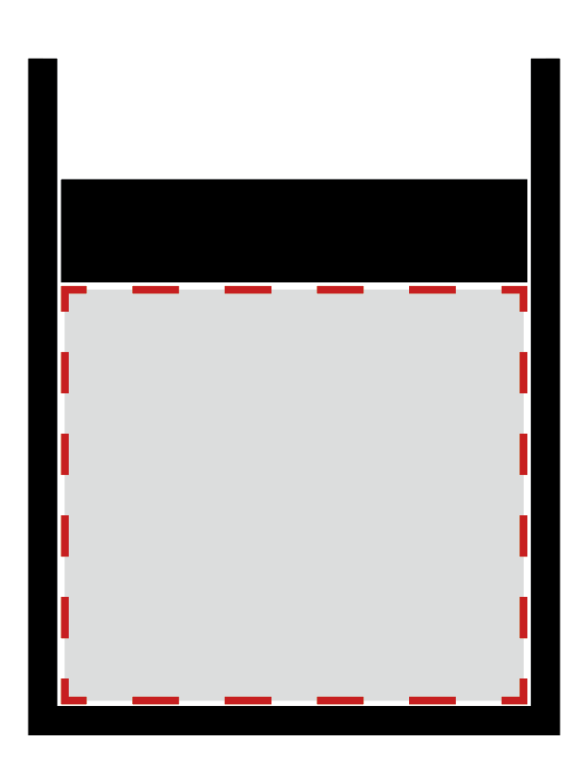
Properties of pure substances
Thermodynamic description of the working fluids:
  Water
  Refrigerants (Ammonia, R134a, ...)
  Gases – (often approximated as
  ideal gases)
  Hydrocarbons
Studying thermodynamic properties
of different phases of matter.
T = 20°C
v = 1.5 m³/kg

Slide 22
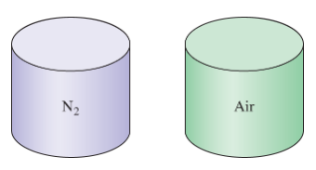
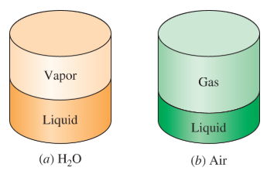
Pure substances
Definition: a fluid with a uniform chemical composition
Yes
No
Notes:
Different components of air condensing at different temperatures

Slide 23
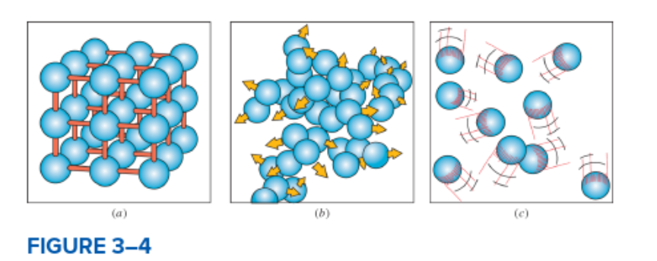
Phases of matter
Fluid
Solid
Liquid
Gas
Melting
Freezing
Vaporizing
Condensation
Sublimation
Deposition (resublimation)

Slide 24
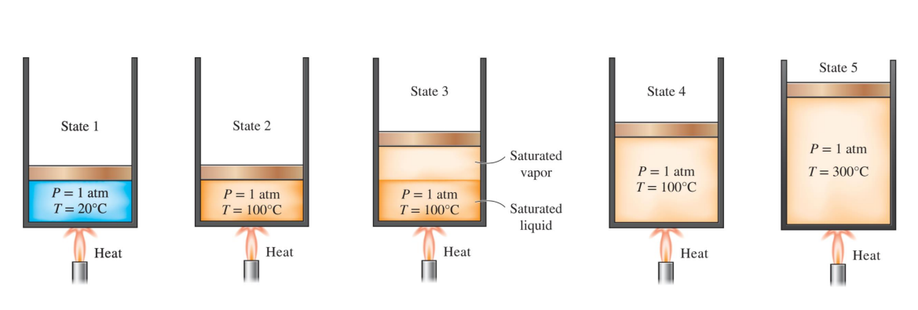
Phase change processes of pure substances
Example: isobaric heating of Water
Notes:
Temperature will remain constant during phase change process
Large increase in the volume will occur

Slide 25
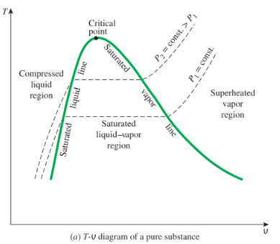
T-v diagram for pure substances
T-v diagram of a pure substance
Notes:
Explain process from before
Heat of vaporization
Explain diagram:
Dome lines
Regions
How do isobars run in this diagram

Slide 26
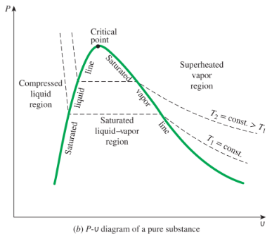
P-v diagram for pure substances
P-v diagram of a pure substance
Notes:
Alternative illustration
Explain diagram
Explain how the isotherms run in this diagram

Slide 27
Summary
Understand energy analysis of open systems and cycles.
Define energy conversion efficiency.
Introduced pure substances and respective phase change processes.

Slide 28
Next up
Thermodynamic property diagrams for pure substances.
Procedures on determining the thermodynamic properties of pure substances.

